Slide 1
Team Forecasting

Slide 2
Agenda
1
Problem Statement
2
EDA
3
Hypothesis
4
Feature Engineering
5
Model Selection
6
Model Development and Tuning
7
Conclusion

Slide 3
What is our Problem Statement ?
Forecasting Emergency Room (ER) Admissions
By leveraging historical admission data forecasting of ER admissions helps hospitals optimize staff scheduling, resource allocation, and patient care planning. Objectives:
Trend & Seasonality Analysis: Analyze historical ER admission patterns to identify trends and seasonal effects.
External Factor Integration: Incorporate weather, festivals, disasters, and public holidays into forecasting.
Predictive Model Development: Build models to accurately forecast daily admission volumes.
Staff Scheduling Optimization:
Align staffing plans with forecasted patient demand.
Reduce Operational Costs Avoid overstaffing or underutilization by aligning resources to predicted demand.

Slide 4
Understanding the Challenges faced by the hospital
Unpredictable Patient Inflow: Daily ER admissions fluctuate due to unpredictable accidents, illnesses, and environmental conditions.
Strained Resource Allocation: Misjudged patient flow leads to costly overstaffing or dangerously low staff availability.
Inadequate Response to External Events: Hospitals lack real-time foresight to prepare for disasters, pandemics, and large-scale public events.
Seasonal and Event-Driven Surges: Admission volumes spike during seasons or festivals, often catching hospitals unprepared.
Impact on Patient Care Quality: Inaccurate forecasts compromise patient wait times, treatment quality, and safety.
Financial Strain and Operational Inefficiency: Poor planning leads to excessive staffing costs, resource shortages, and supply waste.

Slide 5
Solution that we are offering!
1. Comprehensive Data Analysis:
Data Integration:
We will consolidate historical hospital admission data along with external datasets including weather reports, festival dates, disaster alerts, and pandemic records ensuring all influential factors are aligned for analysis.
Historical Data Utilization:
We will analyze admission patterns over time to uncover trends, seasonality, and external event impact, helping us understand what factors drive daily fluctuations in ER visits.
2. Predictive Lead Scoring Model Development:
Hypothesis Formation:
Based on our exploration of historical admissions and external factors, we will form hypotheses around how weekends, weather, holidays, and disasters impact ER demand.
Feature Engineering:
We will create meaningful features from the data including temporal features (day, month, season), weather variations, public events, and lagged admission values to strengthen the model’s predictive power.
Model Training and Tuning:
We will develop a robust time series forecasting models : ARIMAX, Prophet and machine learning models : XGBoost, LightGBM and optimize the hyperparameters to ensure accurate, reliable, and explainable predictions for daily ER admissions.

Slide 6
Agenda
1
Problem Statement
2
EDA
3
Hypothesis
4
Feature Engineering
5
Model Selection
6
Model Development and Tuning
7
Conclusion

Slide 7
Dataset Overview:
The dataset is sourced from Elsevier’s Open-Access Repository, titled “An open-access dataset of emergency department admissions at a large teaching hospital.”
This dataset records daily emergency department (ER) admissions and associated external factors such as:
Date & Time of Admission
Patient Demographics
The dataset provides a real-world scenario for understanding patterns of ER demand and testing forecasting models under practical conditions.
Why the Chosen Dataset?
Balanced & Comprehensive: The Elsevier dataset includes historical admissions giving us the complete context needed for effective forecasting.
Real-World Data: It’s sourced from a large teaching hospital , providing a diverse and representative sample of hospital operations and external influences, which is closer to real-world scenarios.
Ideal for Time Series: Daily granularity ensures the dataset aligns perfectly with our goal of forecasting daily ER admissions.

Slide 8
External Factors Integrated into the Dataset
To enhance the accuracy of emergency room admission forecasting, we enriched the dataset with external factors, capturing real-world events that can influence patient inflow:
Weather Data (Temperature & Precipitation): Sourced from the Open-Meteo API to capture how weather conditions like temperature extremes and rainfall impact admissions.
Public Holidays & Festivals: Retrieved from the Calendarific API to account for increased hospital visits during holidays and festive periods.
Pandemic Waves (COVID-19): Incorporated known COVID-19 surge periods to assess the impact of pandemics on ER load.
Natural Disaster Events: Added using data from local disaster reports, such as cyclones or floods in Chennai, to account for sudden surges in admissions during disasters.
Weekend Effects: Marked Sundays as weekends to account for the differences in patient inflow on weekends versus weekdays.

Slide 9
Exploratory Data Analysis (EDA) - Overview
Dataset Composition:
The dataset contains 25 columns including patient demographics, admission details, and external factors (weather, events).
Data Quality Assessment:
Checked for missing values and outliers. Applied appropriate handling methods to ensure data integrity.
Descriptive Statistics:
Calculate summary statistics (mean, median, standard deviation) for numerical features and analyze the distribution of categorical variables.
Correlation Analysis:
Generated a correlation matrix to identify relationships between features like demographics, service usage, and external events (pandemic, disaster) for model development.
Key Features:
Resident Date
Total Admissions
Temperature
Precipitation
Event type

Slide 10
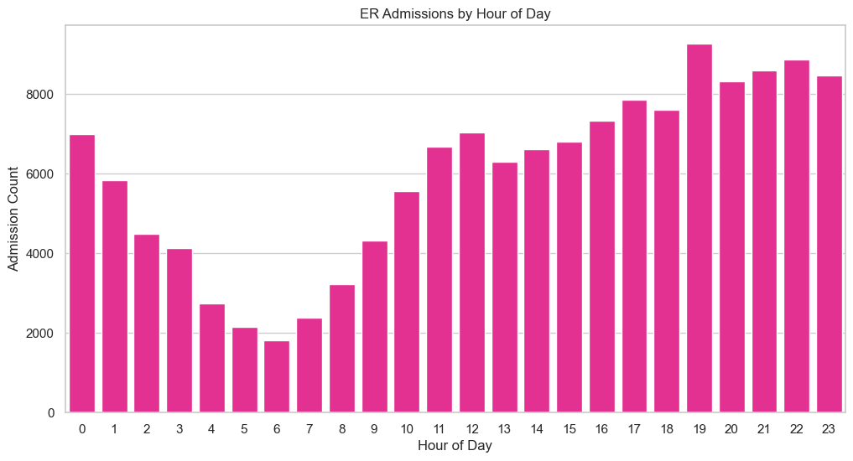
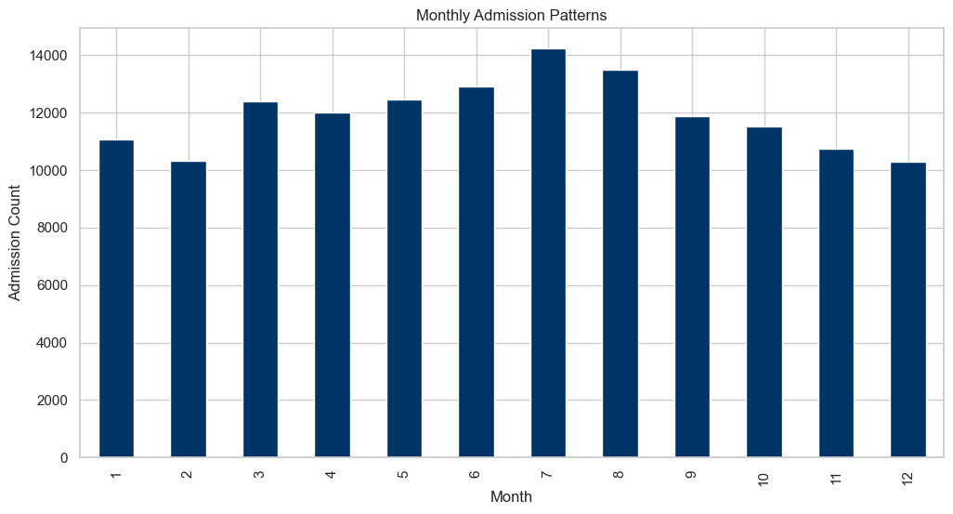
Total Admissions for Each Hour Based
Total Admissions for Each Month Based

Slide 11
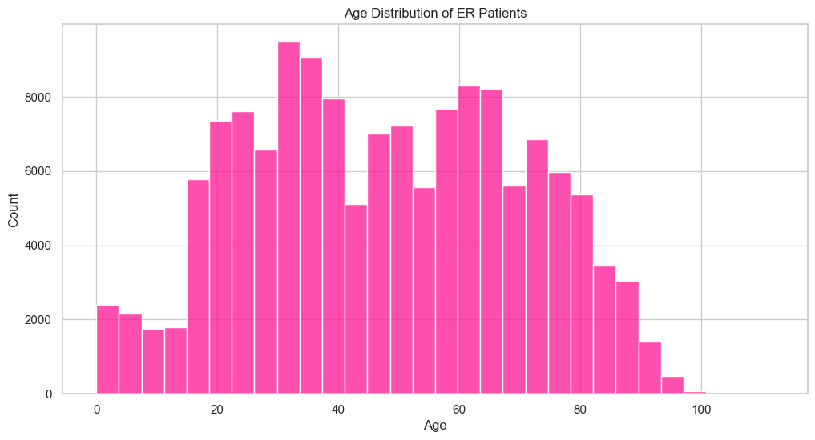
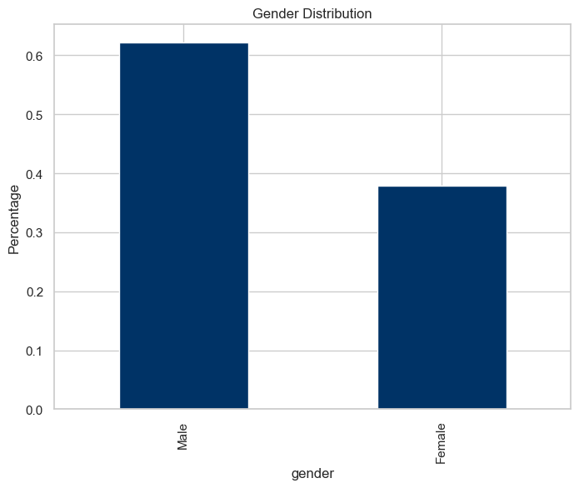
Total Admissions on Age Based
Total Admissions on Gender Based

Slide 12
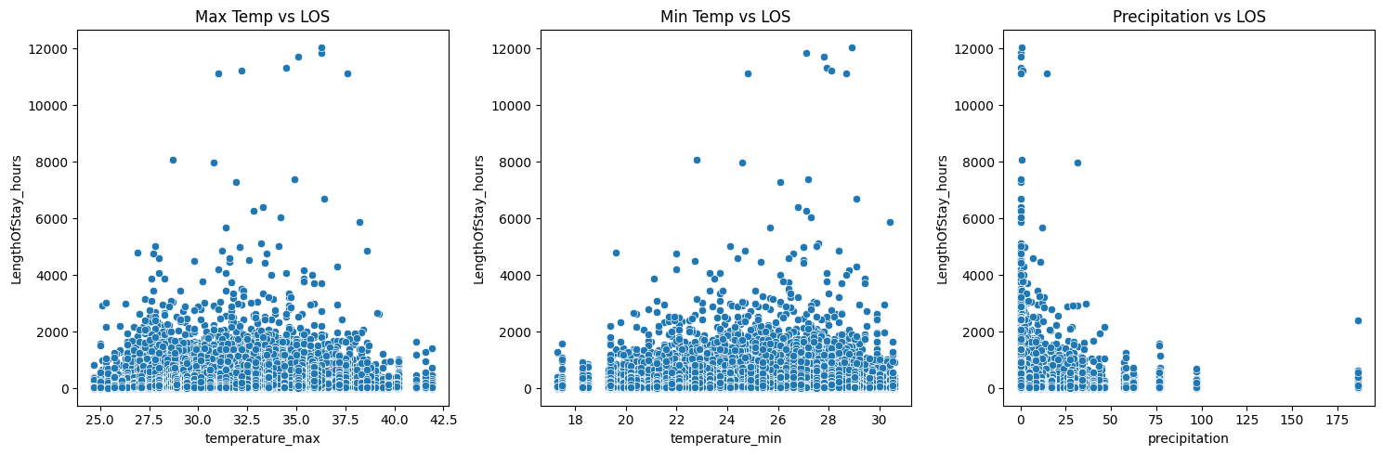
Total Length stay with respect to the temperature

Slide 13
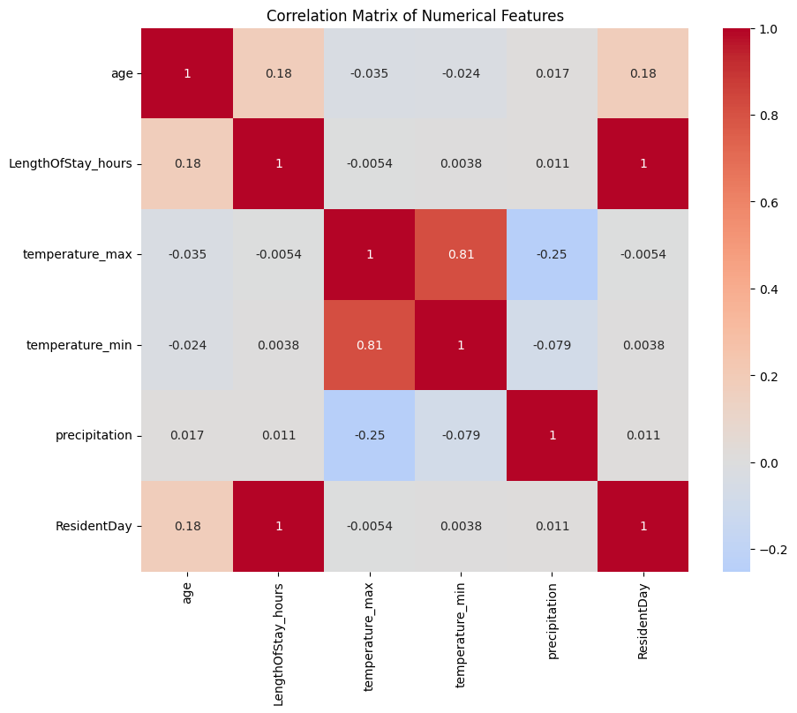
Correlation Matrix

Slide 14
Agenda
1
Problem Statement
2
EDA
3
Hypothesis
4
Feature Engineering
5
Model Selection
6
Model Development and Tuning
7
Conclusion

Slide 15
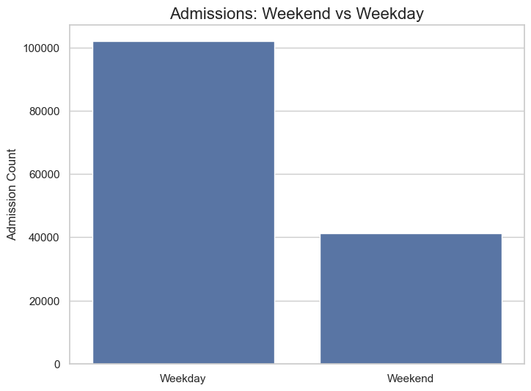
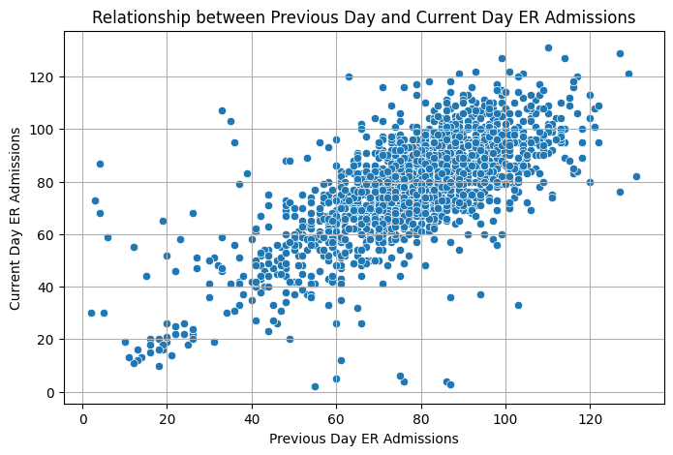
Total Number of Admissions with the Weekend and Weekday
Relatonship Between Previous and Current Day with Admissions

Slide 16
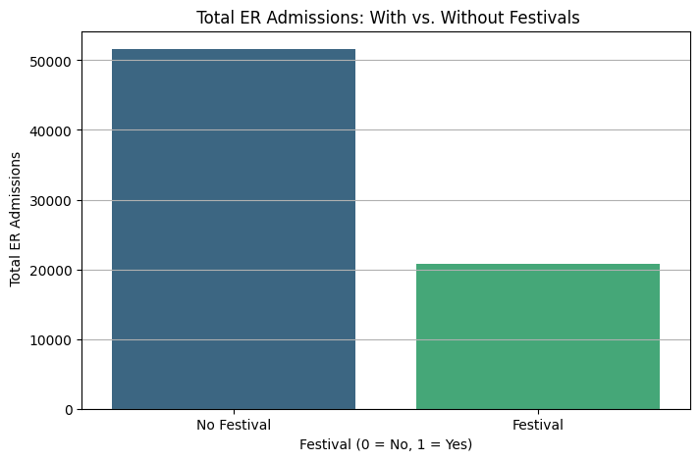
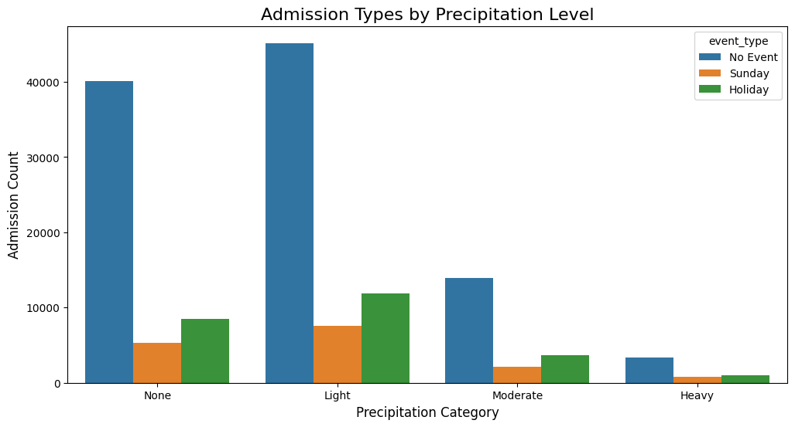
Impact of Festivals on Admissions
Impact on Admissions due to Precipitation

Slide 17
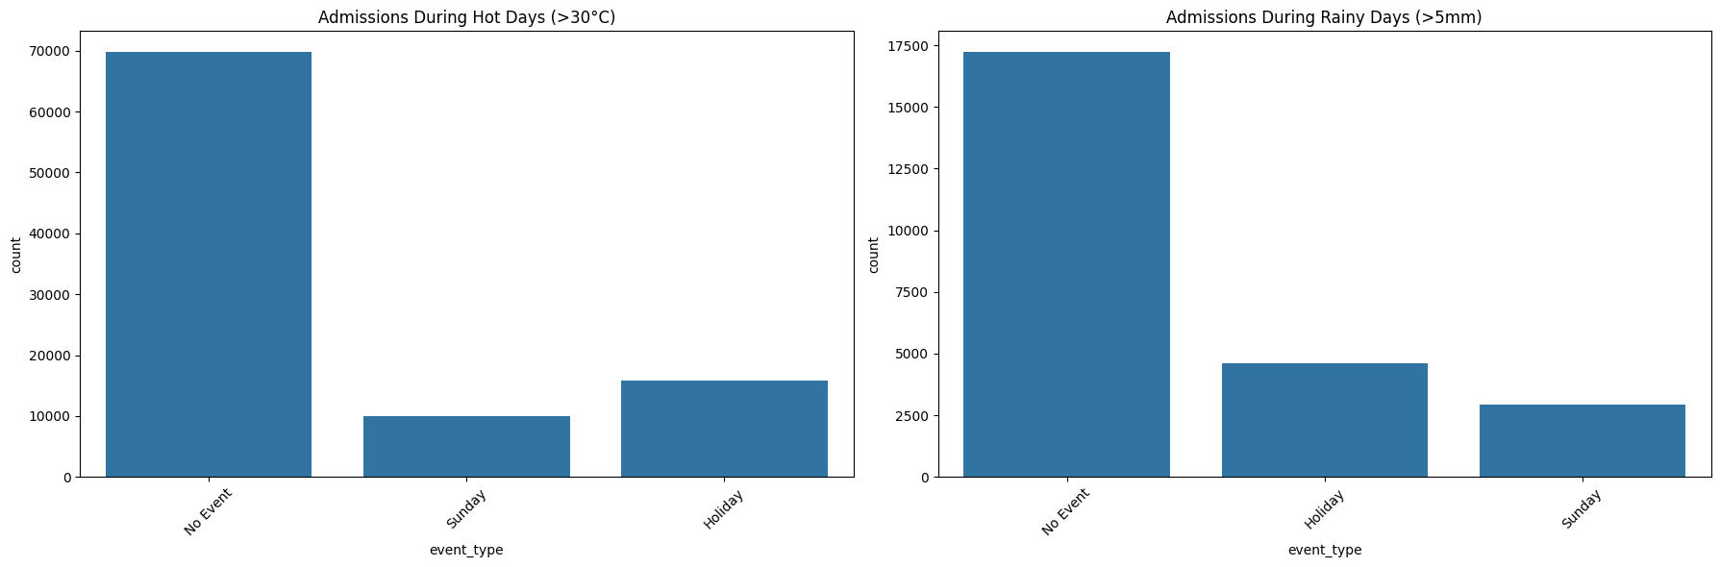
Temperature that effects the Admissions Due to the Holidays

Slide 18
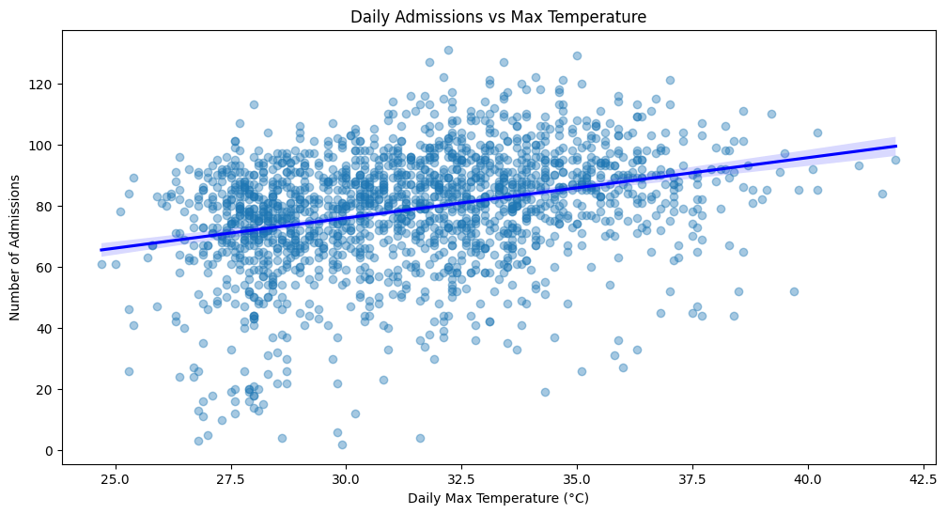
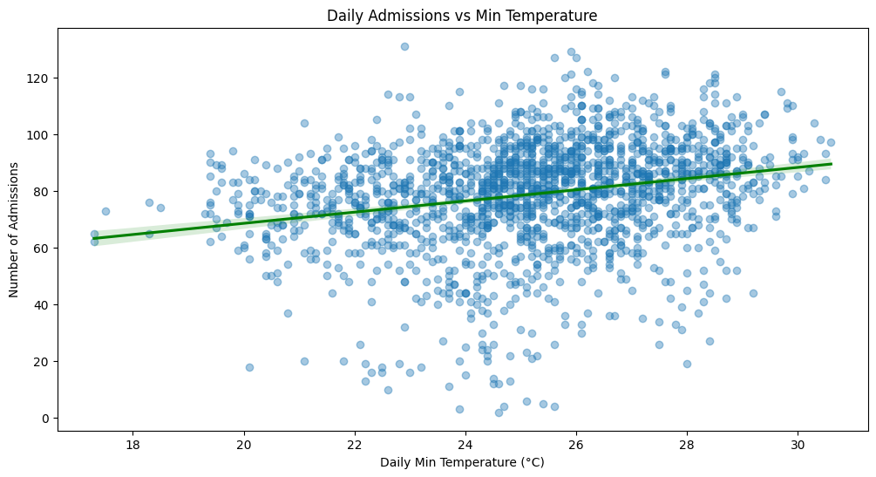
How Temperature changes the Admission Rates

Slide 19
Agenda
1
Problem Statement
2
EDA
3
Hypothesis
4
Feature Engineering
5
Model Selection
6
Model Development and Tuning
7
Conclusion

Slide 20
Feature Engineering Overview
Data Aggregation:
Aggregated daily data by ResidentDate to include total discharges, max/min temperatures, precipitation, and the most frequent event type (holiday/festival).
External Event Features:
Created binary flags for pandemic and disaster (1 if event occurs, 0 if not).
Added Festival flag for event days (1 for event, 0 for no event).
Time-Based Features:
Extracted Year, Month, Day, Weekday, and Weekend indicator (1 for weekend).
Added Season based on month.
Weather Features:
Calculated Temperature Range and Rain Indicator (1 if precipitation occurs).
Lag/Rolling Features:
Created Lag features (1-day, 7-day) for admissions.
Added Rolling mean, EMA, standard deviation, min, and max for admissions over 7-day windows.

Slide 21
Features Creation
Feature | Description | Why it's important
ResidentDate_year | Year component of the date | Captures long-term trends or policy changes.
ResidentDate_month | Month component | Captures monthly or seasonal effects (e.g., flu season).
ResidentDate_day | Day of the month | useful for detecting patterns tied to dates ( end-of-month spikes).
ResidentDate_weekday | Day of the week (0=Monday) | Weekday effects ( higher traffic on weekends or Mondays).
is_weekend | 1 if Saturday or Sunday | Binary flag to isolate weekend-specific trends.
Season | 1: Winter, 2: Spring, 3: Summer, 4: Fall | Groups months into seasons — useful for disease and injury seasonality.
temperature_max | Max temp of the day | High temps can lead to heat strokes, dehydration.
temperature_min | Min temp of the day | Low temps may lead to flu, hypothermia.
temp_range | Difference between max and min temp | Captures volatility in temperature — abrupt changes might affect health.
Precipitation | Total rainfall/snowfall | Rain/snow can increase injuries/accidents.
is_rain | Binary flag: was there any rain? | Simplifies the effect of rain into a yes/no feature.

Slide 22
Features Creation
Feature | Description | Why it's important
Total_Admissions_Lag1 | Admissions from the previous day | Captures short-term continuity (e.g., if yesterday was busy, today might be too).
Total_Admissions_Lag7 | Admissions from the same day last week | Captures weekly seasonality (e.g., Sundays are usually low/high).
Total_Admissions_MA7 | 7-day moving average | Smooths daily fluctuations, good for identifying trend.
Total_Admissions_MA14 | 14-day moving average | Smoother long-term trend indicator.
Total_Admissions_EMA | Exponential moving average (7-day) | Weights recent days more, useful for momentum detection.
Total_Admissions_Rolling_Std | Rolling standard deviation over 7 days | Measures volatility in admissions.
Total_Admissions_Rolling_Min | Minimum admissions in past 7 days | Captures floor behavior, useful for detecting low-volume periods.
Total_Admissions_Rolling_Max | Maximum admissions in past 7 days | Captures peak days, helpful in outlier or surge prediction.
Festival | 1 if any special event occurred that day | Public events can cause spikes in ER visits
disaster_flag | 1 if a disaster occurred | Disasters increase sudden ER demand.

Slide 23
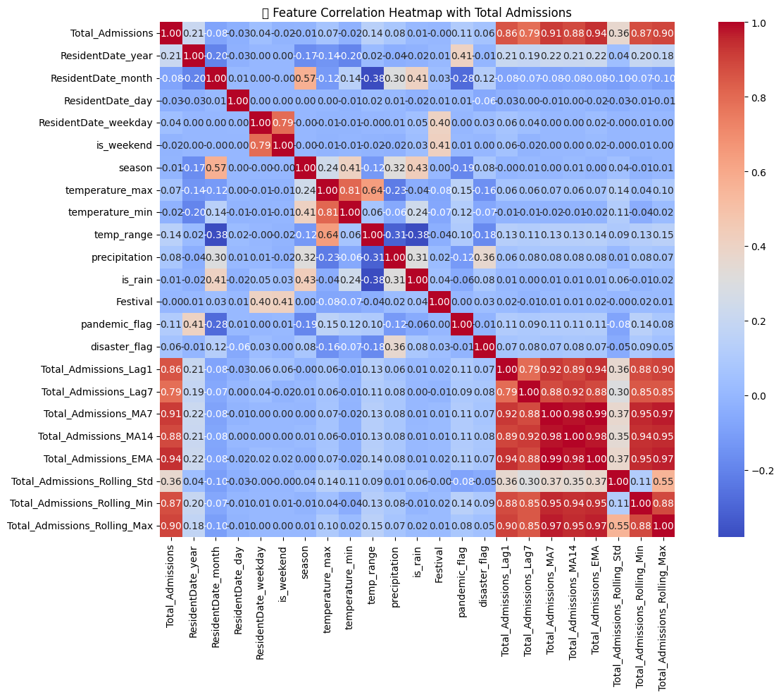
Feature Engineering Correlation Matrix

Slide 24
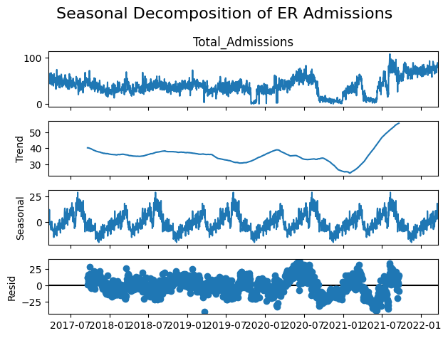
Seasonality Analysis

Slide 25
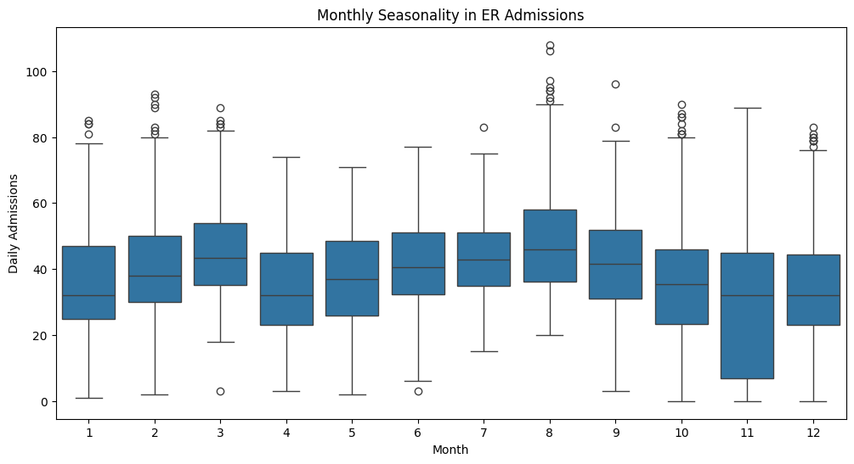
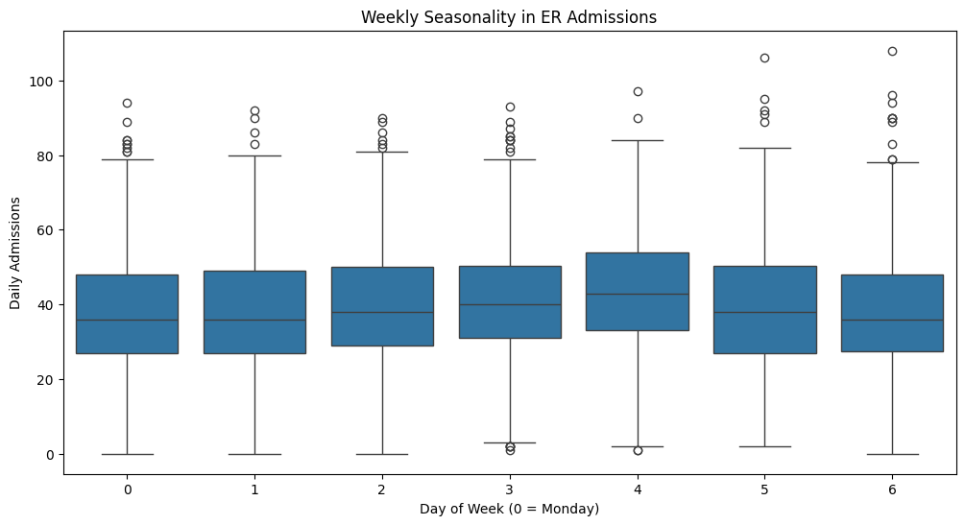
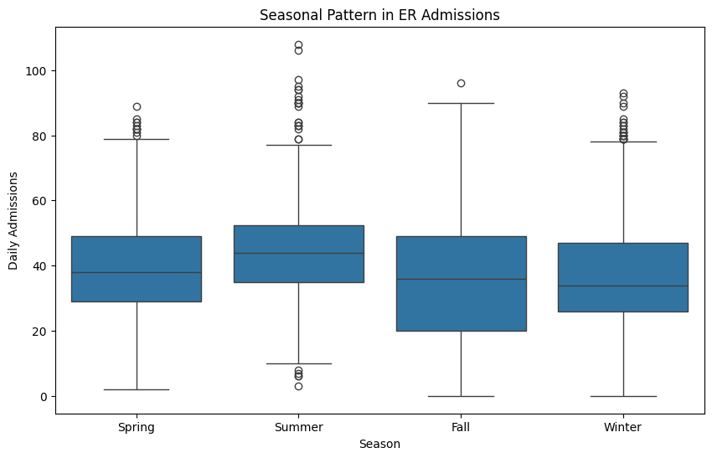
Seasonality Analysis

Slide 26
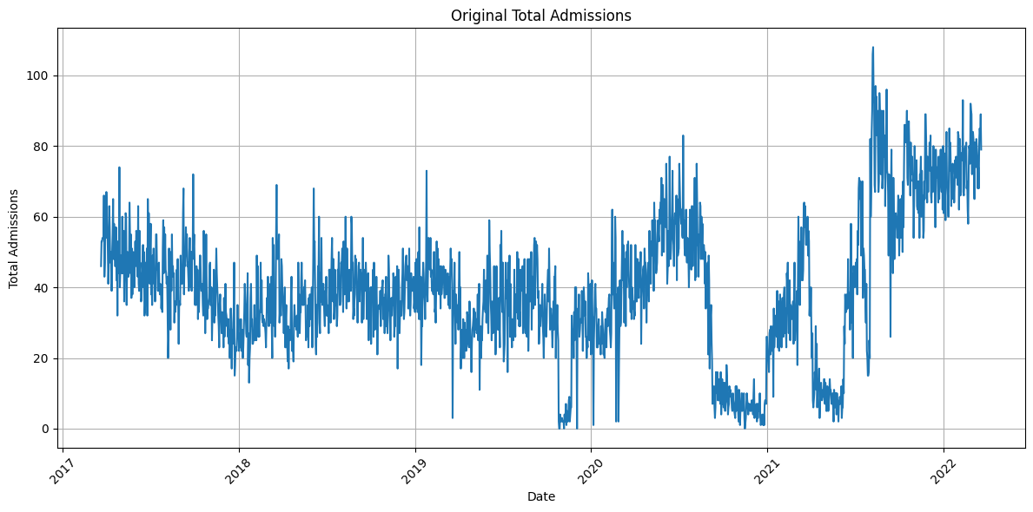
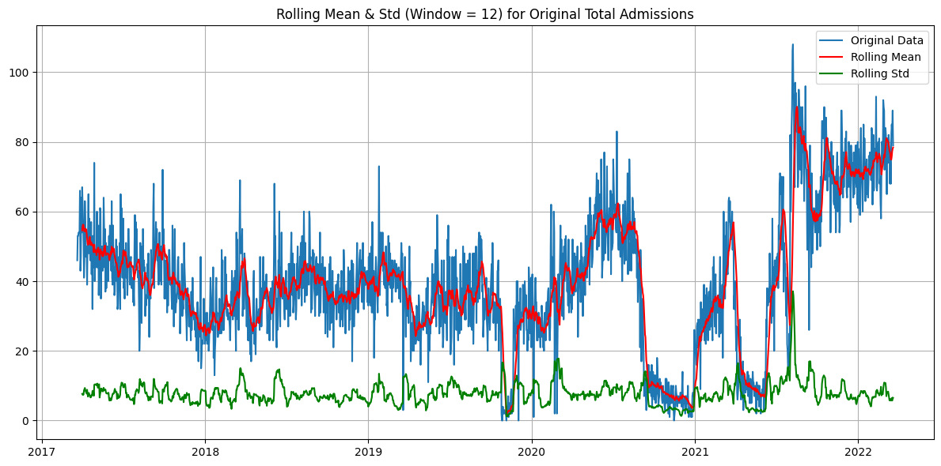
Seasonality Analysis

Slide 27
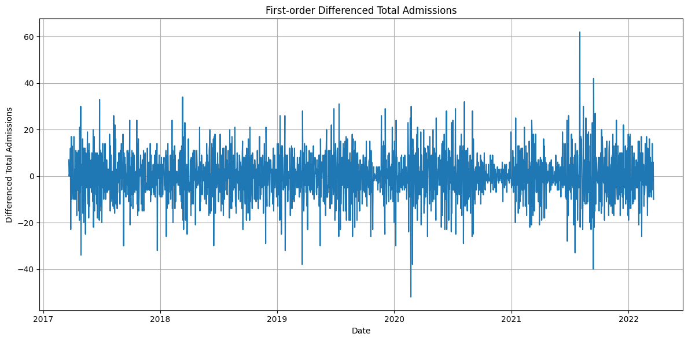
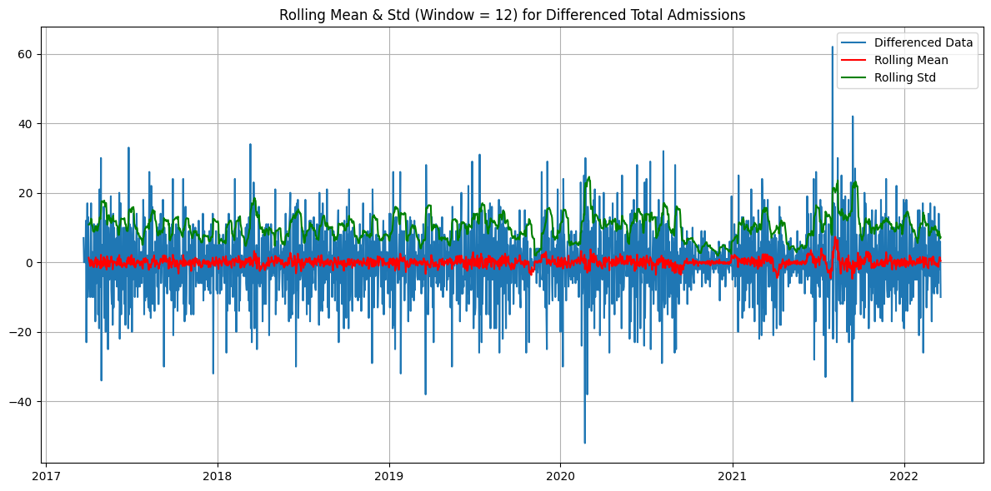
Seasonality Analysis

Slide 28
Agenda
1
Problem Statement
2
EDA
3
Hypothesis
4
Feature Engineering
5
Model Selection
6
Model Development and Tuning
7
Conclusion

Slide 29
Model Selection
ARIMA
Forecasts with time series data
Strength: Handles temporal dependencies effectively for short-term predictions.
SARIMAX
ARIMAX with seasonality inclusion
Strength: Handles seasonal patterns and external events.
Prophet
Forecasts with multiple seasonalities and holidays
Strength: Easy to use, robust to missing data, handles holidays well.
XGBoost
Gradient boosting for regression and classification
Strength: High accuracy, handles non-linear patterns, works well with large datasets.
LightGBM
Faster gradient boosting with leaf-wise growth
Strength: Efficient for large datasets, faster than XGBoost.

Slide 30
Agenda
1
Problem Statement
2
EDA
3
Hypothesis
4
Feature Engineering
5
Model Selection
6
Model Development and Tuning
7
Conclusion

Slide 31
Difference Between the Models
Feature | ARIMA | SARIMAX | Prophet | XGBoost | LightGBM
Model Type | Statistical | Statistical | Additive model (Bayesian-inspired) | Machine Learning (Boosted Trees) | Machine Learning (Boosted Trees)
Handles Seasonality | Manual differencing needed | Built-in seasonal terms | Multiple seasonalities (weekly, yearly) | Needs engineered seasonal features | Needs engineered seasonal features
Supports Exogenous Vars | No | Yes | Yes (e.g., holidays, events) | Yes | Yes
Handles Missing Data | Poorly | Poorly | Robust | Needs imputation | Needs imputation
Ease of Use | Complex (parameter tuning) | Complex (more params) | Simple API (Facebook-developed) | Moderate (feature prep required) | Moderate (feature prep required)
Non-linear Relationships | Linear only | Linear only | Limited (piecewise linear trends) | Excellent | Excellent
Computational Speed | Fast for small data | Slower with many variables | Reasonable | Slower than LightGBM | Very Fast (optimized for performance)
Interpretability | High | High | Decent (components plot) | Medium (feature importance) | Medium (feature importance)
Best For | Short-term forecasting | Seasonal + external variable models | Business forecasting (e.g. with holidays) | Large/tabular datasets with interactions | Large datasets where speed is a priority

Slide 32
Model Evaluation
Model | Mean Absolute Error | Mean Squared Error | Root Mean Squared Error
ARIMA | 23.07 | 724.27 | 26.91
SARIMAX | 7.10 | 86.36 | 9.29
PROPHET | 6.85 | 78.42 | 8.86
XGBOOST | 10.18 | 205.34 | 14.33
LIGHTGBM | 9.73 | 197.40 | 14.05

Slide 33
Best Model
The script performs time series forecasting on hospital admissions data using the Prophet model. It starts by importing necessary libraries and loading the dataset, which includes hospital admissions along with engineered features such as weather data, lag values, rolling statistics, and day-of-week indicators. The data is formatted to match Prophet’s input requirements, with the date column labeled as 'ds' and the target variable as 'y'.
To improve forecasting accuracy, a set of exogenous regressors is added to the model. Prophet is trained on the historical data, including these additional variables. A future dataframe is created to project admissions 90 days ahead, with the corresponding future values for each regressor included. The model then generates predictions, which are visualized along with confidence intervals.
The forecasted results for the next 90 days are extracted and displayed in tabular form. To evaluate model performance, the dataset is split into training and testing sets. The model predicts admissions for the test set, and its accuracy is measured using standard evaluation metrics: mean absolute error (MAE), mean squared error (MSE), and root mean squared error (RMSE). These metrics help assess how well the model generalizes to unseen data.

Slide 34
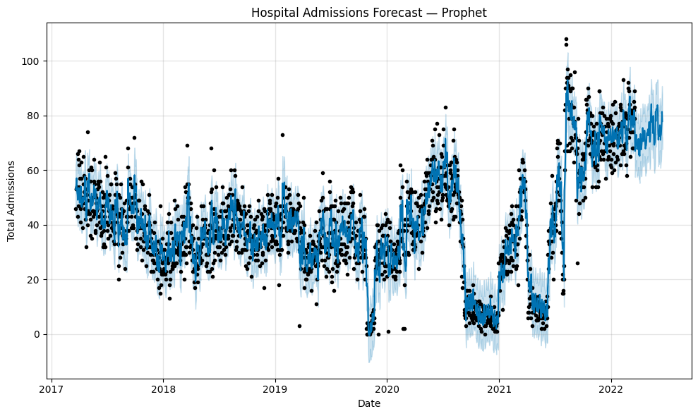
Forecasting the Admissions

Slide 35
Agenda
1
Problem Statement
2
EDA
3
Hypothesis
4
Feature Engineering
5
Model Selection
6
Model Development and Tuning
7
Conclusion

Slide 36
Conclusion
Ultimately, this forecasting model provides valuable insights to hospital administrators, enabling data-driven decisions for staff scheduling, resource allocation, and preparedness for high-demand days. The methodology developed can also be adapted to other hospitals or health systems with similar datasets.

Slide 37
Thank You

